Slide 1
Liver Cirrhosis Analysis
Transition from Stage 3 to 4
BYUNGHYUN HWANG

Slide 2
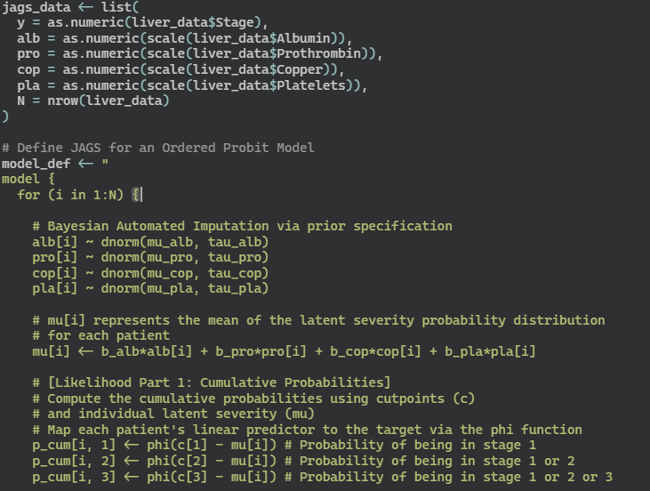
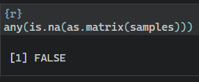
DATA SET & JAGS MODEL
DATA SET
JAGS (Ordered Probit Model)
Data Source: Mayo Clinic liver
cirrhosis dataset (1974–1984)
Total Observations: 412 having target feature
Selected Predictive Features
Albumin (alb)
Copper (cop)
Platelets (pla)
Prothrombin Time (pro)
Missing Values
Copper (cop): 102
Platelets (pla): 11
Prothrombin Time (pro): 2
Target Feature (Ordinal)
Cirrhosis Stage 1
Cirrhosis Stage 2
Cirrhosis Stage 3
Cirrhosis Stage 4
(Continued on
Next Slide...)
1

Slide 3
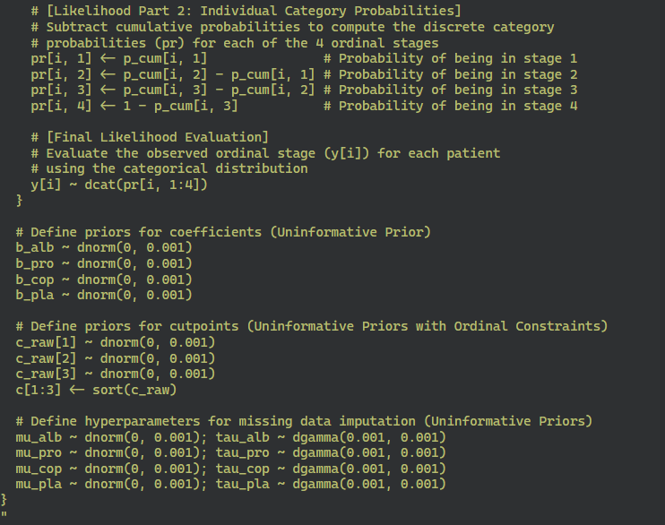
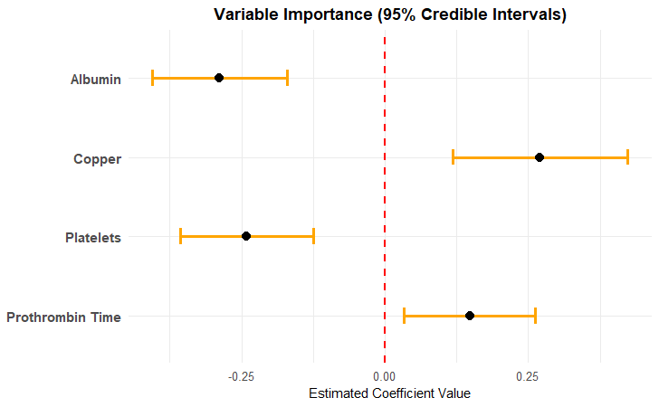

JAGS MODEL & OUTCOMES
JAGS (Ordered Probit Model)
VARIABLE IMPORTANCE
To eliminate subjective bias as a non-medical expert, uninformative priors were utilized.
2

Slide 4
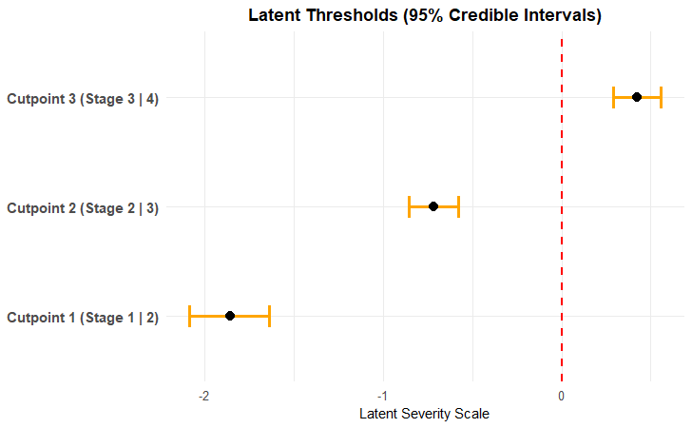
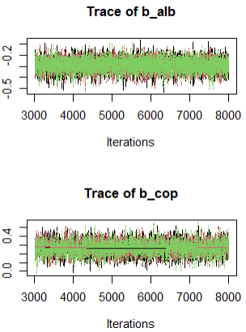
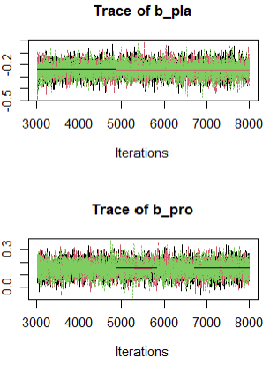
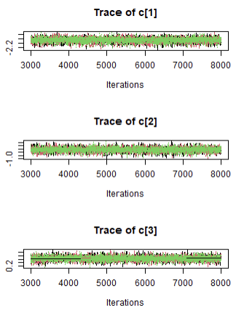
OUTCOMES
STAGE THRESHOLDS
CONVERGENCE
The well-mixed 'hairy caterpillar' trace plots suggest successful convergence of the estimated variables and stage thresholds.
3

Slide 5
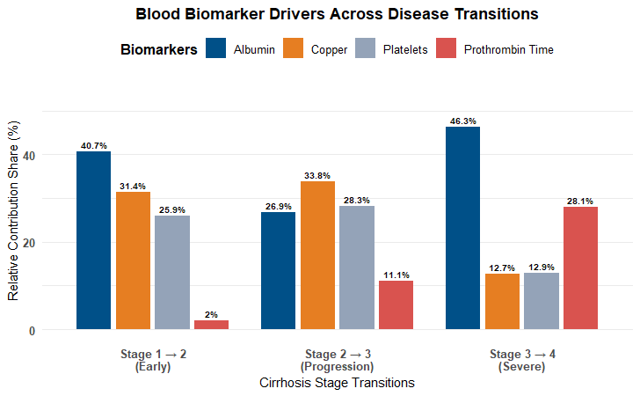
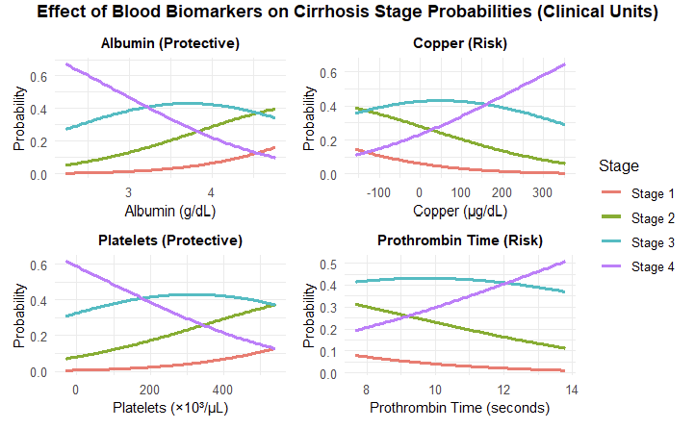
RESEARCH QUESTION 1 & 2
RQ1. What is the most influential blood biomarker for each distinct stage transition?
RQ2. How do clinical changes in blood biomarkers affect stage 4 probability?
During the early transition (stage 1 to 2): Albumin (40.7%)
Transition point of Albumin: less than 3.3
During the progression transition (stage 2 to 3): Copper (33.8%)
Transition point of Copper: over 150
During the severe transition (stage 3 to 4): Albumin (46.3%)
Transition point of Platelets: less than 200
4
Transition point of Prothrombin Time: over 12.5

Slide 6
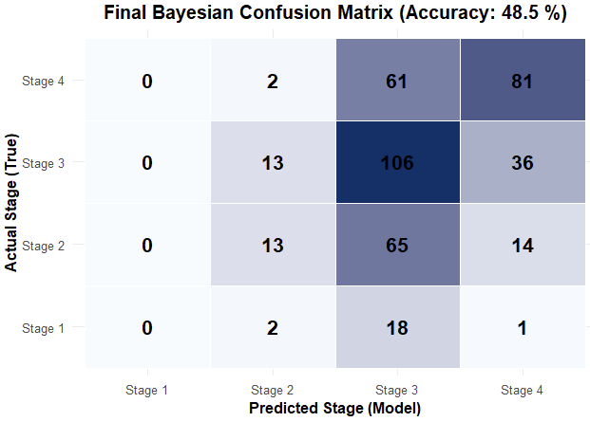
RESEARCH QUESTION 3
RQ3. How accurately can the Bayesian Ordered Probit model
predict patients in stage 3 and 4?
A high safety tool with 0 advanced patients
misclassified into stage 1
A sensitivity of approximately 68% (106/155)
for stage 3
A sensitivity of approximately 56% (81/144)
for stage 4
May consider other features to enhance model accuracy for future studies
5

Slide 7
The End

